Slide 1
Representing Relation
IT-209: Discrete Mathematics

Slide 2
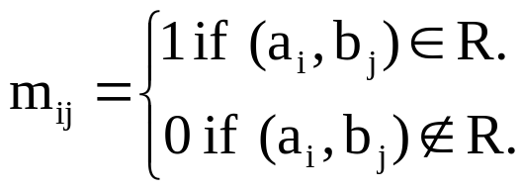
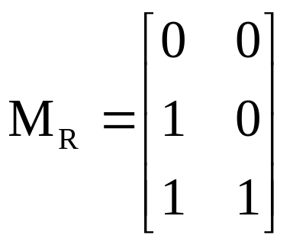
Matrix Representation of Relations
A relation between sets can be presented using zero-one matrix.
Suppose A relation R from set A = {a₁, a₂, ….., a_{m}} to B = {b₁, b₂, ….., b_{n}} can be represented as matrix M_{R} = [m_{ij}], where
  Example: A relation R between set A = {1, 2, 3} and B={1, 2}. Let R contains (a, b) if a ∈ A, b ∈ B and a > b. What would be the matrix representation of R if a₁ = 1, a₂ = 2, a₃ = 3 and b₁ = 1, b₂ = 2?
  Solution: R = {(2, 1), (3, 1), (3, 2)}. The matrix for R is:

Slide 3
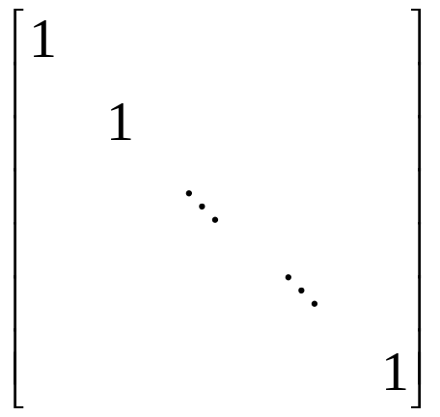
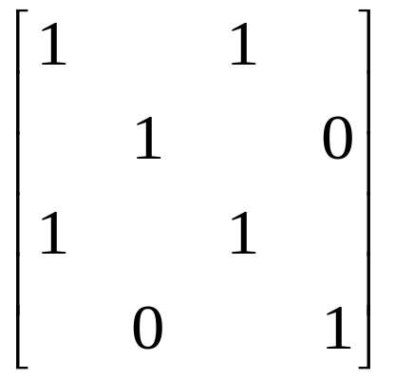
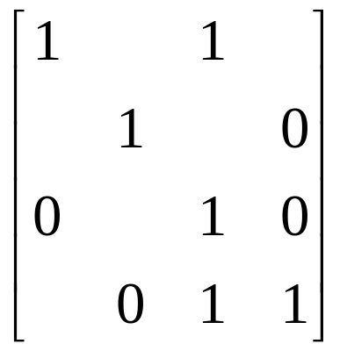
Matrix Representation of Properties of Relations
Symmetric
Antisymmetric
Reflexive

Slide 4
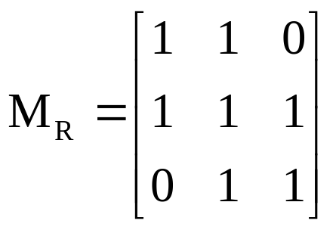
Example on Properties
Suppose that the relation R on a set is represented by the matrix M_{R} , Is R reflexive, symmetric and/or antisymmetric?
Solution:
  As the diagonal elements of the matrix is 1, so R is reflexive.
  It is also symmetric as the opposite positions are 1, so R is symmetric.
  So we can say that R is not antisymmetric.

Slide 5
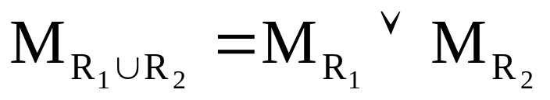

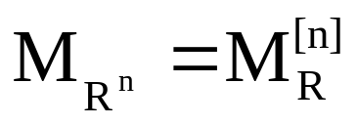
Combining Relations into Matrix form
M_{S ○ R} = M_{R} ʘ M_{S}

Slide 6
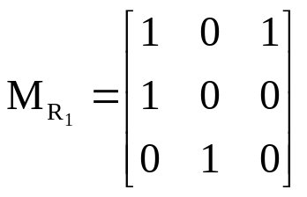
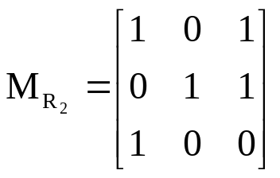
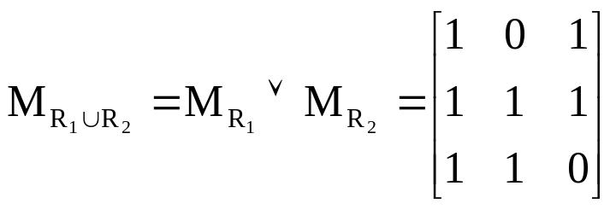
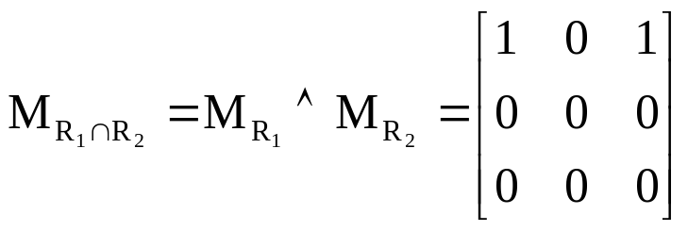
Examples
Suppose R₁ and R₂ on set A are represented by the matrices given below. Find R₁ ∪ R₂ and R₁ ∩ R₂.

Slide 7
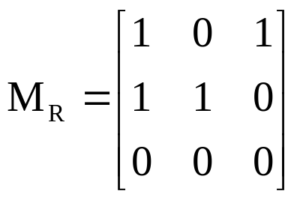
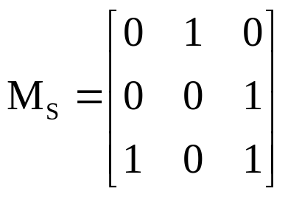
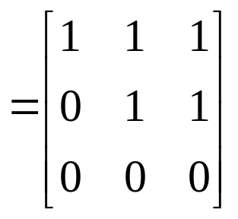
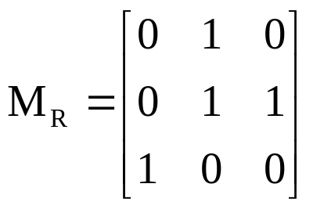
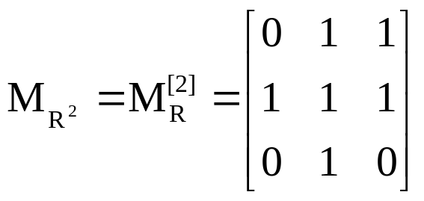
Examples
Find the matrix representing the relation S ○ R, where S and R is given as:
M_{S ○ R} = M_{R} ʘ M_{S}
Find the matrix representing the relation R², where R is given as:

Slide 8
Representing Relation Using Diagraphs
A directed graph or diagraph consists of set V of vertices (nodes) together with a set E of edges (arcs). The vertex a is called the initial vertex and b is called the terminal vertex of edge (a, b).
A edge from vertex a to a is called a loop, represented in form (a, a).
  Example: The directed graph of the relation R on set {1, 2, 3, 4} shown as: where, R = {(1, 1), (1, 3), (2, 1), (2, 3), (2, 4), (3, 1), (3, 2), (4, 1)}
1
2
4
3

Slide 9
Thank You
Study all the solved problem from your text book.
Try to solve related problems from exercise.
Text from Rosen 8.3

